Slide 2
LEARNING OUTCOMES
At the end of this chapter, students will be able to:
Describe the steps involved in the project initiation and planning process.
Explain the need for and the contents of a Project Scope Statement and Baseline Project Plan.
List and describe various methods for assessing project feasibility.
Describe the differences between tangible and intangible benefits and costs and between one-time vs. recurring benefits and costs.
Perform cost-benefit analysis and describe what is meant by time value of money, present value, discount rate, net present value, return on investment, and break-even analysis.

Slide 3
TOPIC OUTLINES
Introduction
3.1 Initiating and Planning Systems Development Projects (PIP)
3.2 The Process of Initiating and Planning Information System Development Project
3.2.1 Elements of Project Planning
3.3 Assessing Project Feasibility
3.3.1 Feasibility Analysis (FA)
3.3.2 Determining Project Benefits
3.3.3 The Time Value of Money
3.3.4 Assessing Technical Feasibility
3.3.5 Other Feasibility Studies
3.3.6 Building the Baseline Project Plan

Slide 4
3.1 Initiating and Planning Systems Development Projects (PIP)
What must be considered when making the decision on the division between project initiation and planning (PIP) and analysis?
The time and effort spent on PIP reduces time in the later project phases
The actual time expended is affected by the size, experience of the staff in developing similar system and the complexity of the project as well
The project initiation stage will enable the organisation to establish the scope of the project, discover its boundaries and specify what project deliverables are expected to be produced.
How much effort should be expended on the PIP process?
Who is responsible for performing the PIP process?
Why is PIP such a challenging activity?
Click each button to find out more.

Slide 5
3.1 Initiating and Planning Systems Development Projects (PIP)
What must be considered when making the decision on the division between project initiation and planning (PIP) and analysis?
How much effort should be expended on the PIP process?
An experienced system analyst or a team of analysts for large projects is responsible in performing PIP.
The system analyst will work with the managers, users and technical development staff of the system
Who is responsible for performing the PIP process?
Why is PIP such a challenging activity?
Click each button to find out more.

Slide 6
3.1 Initiating and Planning Systems Development Projects (PIP)
What must be considered when making the decision on the division between project initiation and planning (PIP) and analysis?
How much effort should be expended on the PIP process?
The objective of PIP is to transform the requested system into tangible project description
Effective communication among the system analyst, users and management is important for the creation of a meaningful project plan
Who is responsible for performing the PIP process?
Why is PIP such a challenging activity?
Click each button to find out more.

Slide 7
3.2 The Process of Initiating and Planning Information System Development Project
Project Identification and Selection take place in the planning phase
Project identification and Selection
Project Initiation and Planning
Systems development life cycle with project initiation and planning highlighted
Planning
Maintenance
Analysis
Implementation
Design
Fig. 13

Slide 8
3.2 The Process of Initiating and Planning Information System Development Project
Project initiation focuses on activities designed to assist in organizing a team to conduct project planning.
The elements of project initiation are:
Establishing the Project Initiation Team.
Establishing a Relationship with the Customer.
Establishing the Project Initiation Plan.
Establishing Management Procedures.
Establishing the Project Management Environment and Project Workbook.
Developing the Project Charter.

Slide 9
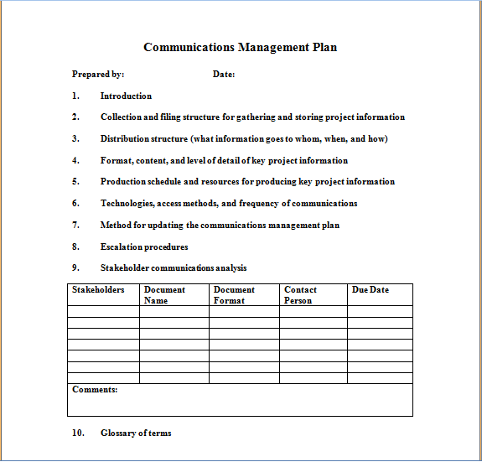
3.2 The Process of Initiating and Planning Information System Development Project
CLOSE
Fig. 14

Slide 10
3.2 The Process of Initiating and Planning Information System Development Project
The key activity of project initiation is the development of the project charter.
A short document that is prepared for both internal and external stakeholders
Provides a high-level overview of the project
Useful communication tool that helps to assure that the organisations and other stakeholders understand the initiation of a project
Sample Project Charter Form
Notes:
http://weblog.raganwald.com/2007/02/programming-language-stories.html
Do you know how watchtowers are monitoring airplanes programs without clashes?
Do you know how your
Have you ever want to have a robot for your self?
ATM devices..
Traffic lights

Slide 11
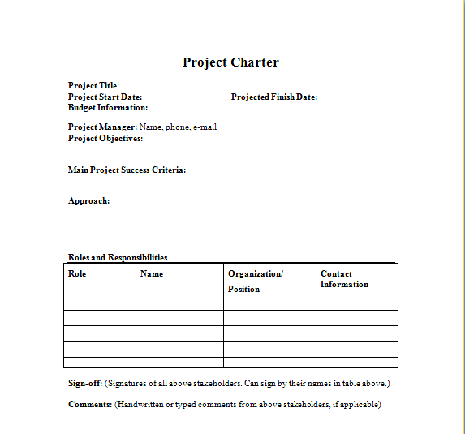
3.2 The Process of Initiating and Planning Information System Development Project
CLOSE
Fig. 13

Slide 12
3.2 The Process of Initiating and Planning Information System Development Project
The key activity of project planning is the process of defining clear, discrete activities and the work needed to complete each activity within a single project.
The objective of the project planning process is the development of a Baseline Project Plan (BPP) and the Project Scope Statement (PSS).
The major outcomes and deliverables from project initiation and planning phase are the Baseline Project Plan (BPP) and the Project Scope Statement
Notes:
http://weblog.raganwald.com/2007/02/programming-language-stories.html
Do you know how watchtowers are monitoring airplanes programs without clashes?
Do you know how your
Have you ever want to have a robot for your self?
ATM devices..
Traffic lights

Slide 13
3.2 The Process of Initiating and Planning Information System Development Project
3.2.1 Elements of Project Planning
1
Describe project scope, alternatives, feasibility.
2
Divide project into tasks.
3
Estimate resource requirements and create resource plan.
4
Develop preliminary schedule.
3
Develop communication plan.
6
Determine standards and procedures.
7
Identify and assess risk.
8
Create preliminary budget.
9
Develop a statement of work.
10
Set baseline project plan.
Notes:
http://weblog.raganwald.com/2007/02/programming-language-stories.html
Do you know how watchtowers are monitoring airplanes programs without clashes?
Do you know how your
Have you ever want to have a robot for your self?
ATM devices..
Traffic lights

Slide 14
3.2 The Process of Initiating and Planning Information System Development Project
CLOSE
Baseline Project Plan (BPP)
A major outcome and deliverable from the PIP phase Contains the best estimate of a project’s scope, benefits, costs, risks, and resource requirements
Notes:
http://weblog.raganwald.com/2007/02/programming-language-stories.html
Do you know how watchtowers are monitoring airplanes programs without clashes?
Do you know how your
Have you ever want to have a robot for your self?
ATM devices..
Traffic lights

Slide 15
3.2 The Process of Initiating and Planning Information System Development Project
CLOSE
Project Scope Statement (PSS)
A document prepared for the customer Describes what the project will deliver Outlines all high level works required to complete the project
Notes:
http://weblog.raganwald.com/2007/02/programming-language-stories.html
Do you know how watchtowers are monitoring airplanes programs without clashes?
Do you know how your
Have you ever want to have a robot for your self?
ATM devices..
Traffic lights

Slide 16
3.2 The Process of Initiating and Planning Information System Development Project
Class Activity
Which one of the following is one of the elements of project initiation?
Develop Communication Plan
Developing project Charter
Identify Project scope
Develop statement of Work
2. In system development lifecycle, in which phase feasibility study is conducted?
Planning phase
Design phase
Analysis phase
Implementation phase
Answer : B
Answer : A
Notes:
http://weblog.raganwald.com/2007/02/programming-language-stories.html
Do you know how watchtowers are monitoring airplanes programs without clashes?
Do you know how your
Have you ever want to have a robot for your self?
ATM devices..
Traffic lights

Slide 17
3.3 Assessing Project Feasibility
3.3.1 Feasibility Analysis (FA)
Feasibility Analysis guides the organisation whether to proceed with a project
Feasibility Analysis also identifies all related risks of a particular project
Detailing Expected Costs and Benefits
Notes:
http://weblog.raganwald.com/2007/02/programming-language-stories.html
Do you know how watchtowers are monitoring airplanes programs without clashes?
Do you know how your
Have you ever want to have a robot for your self?
ATM devices..
Traffic lights

Slide 18
3.3 Assessing Project Feasibility
3.3.1 Feasibility Analysis (FA) (Cont.)
Factors to be considered in Feasibility Analysis
Economic
Technical
Operational
Scheduling
Legal and Contractual
Political

Slide 19
3.3 Assessing Project Feasibility
3.3.1 Feasibility Analysis (FA) (Cont.)
Factors to be considered in Feasibility Analysis
Economic
Economic feasibility: a process of identifying the financial benefits and costs associated with a development project
Often referred to as a cost-benefit analysis
Project is reviewed after each SDLC phase in order to decide whether to continue, redirect, or kill a project
Economic
Technical
Operational
Scheduling
Legal and Contractual
Political
CLOSE
ECONOMIC
1 of 13

Slide 20
3.3 Assessing Project Feasibility
3.3.2 Determining Project Benefits
Factors to be considered in Feasibility Analysis
Benefits and Costs
CLOSE
Economic
Benefits
Tangible
Intangible
costs
Onetime cost
Recurring cost
Technical
Operational
Scheduling
Legal and Contractual
Political
ECONOMIC
Tangible
Intangible
Go to the next slides to see the detail
2 of 13

Slide 21

3.3 Assessing Project Feasibility
3.3.2 Determining Project Benefits
Factors to be considered in Feasibility Analysis
Tangible benefits refer to items that can be measured in dollars and with certainty.
Examples include:
Reduced personnel expenses,
Lower transaction costs, or
Higher profit margins.
Economic
Technical
Operational
Scheduling
Legal and Contractual
Political
CLOSE
Toy product is selling well!!!
ECONOMIC
Fig.16
3 of 13

Slide 22
3.3 Assessing Project Feasibility
3.3.2 Determining Project Benefits (Cont.)
Factors to be considered in Feasibility Analysis
Most tangible benefits will fit within the following categories :
Cost reduction and avoidance
Error reduction
Increased flexibility
Increased speed of activity
Improvement of management planning and control
Opening new markets and increasing sales opportunities
Economic
Technical
Operational
Scheduling
Legal and Contractual
Political
CLOSE
ECONOMIC
4 of 13

Slide 23
3.3 Assessing Project Feasibility
3.3.2 Determining Project Benefits (Cont.)
Factors to be considered in Feasibility Analysis
Intangible benefits are benefits derived from the creation of an
information system that cannot be easily measured in dollars or with certainty.
May have direct organisational benefits, such as the improvement of employee morale.
May have broader societal implications, such as the reduction of waste creation or resource consumption
Economic
Technical
Operational
Scheduling
Legal and Contractual
Political
CLOSE
ECONOMIC
3 of 13

Slide 24
3.3 Assessing Project Feasibility
3.3.2 Determining Project Benefits (Cont.)
Factors to be considered in Feasibility Analysis
Tangible cost: a cost associated with an information system (IS) that can be measured in dollars and with certainty
IS development tangible costs include:
Hardware costs,
Labour costs, or
Operational costs including employee training and building renovations.
Economic
Technical
Operational
Scheduling
Legal and Contractual
Political
CLOSE
ECONOMIC
6 of 13

Slide 25
3.3 Assessing Project Feasibility
3.3.2 Determining Project Benefits (Cont.)
Factors to be considered in Feasibility Analysis
Intangible cost: a cost associated with an information system that
cannot be easily measured in terms of dollars or with certainty
Intangible costs can include:
Loss of customer goodwill,
Employee morale, or
Operational inefficiency.
Economic
Technical
Operational
Scheduling
Legal and Contractual
Political
CLOSE
ECONOMIC
7 of 13

Slide 26
3.3 Assessing Project Feasibility
3.3.2 Determining Project Benefits (Cont.)
Factors to be considered in Feasibility Analysis
One-time cost: a cost associated with project start-up and
development or system start-up
These costs encompass activities such as:
Systems development,
New hardware and software purchases,
User training,
Site preparation, and
Data or system conversion.
Economic
Technical
Operational
Scheduling
Legal and Contractual
Political
CLOSE
ECONOMIC
8 of 13

Slide 27
3.3 Assessing Project Feasibility
3.3.2 Determining Project Benefits (Cont.)
Factors to be considered in Feasibility Analysis
Recurring cost: a cost resulting from the ongoing evolution and use
of a system
Examples of these costs include:
Application software maintenance,
Incremental data storage expenses,
Incremental communications,
New software and hardware leases, and
Supplies and other expenses (i.e. paper, forms, data center personnel).
Economic
Technical
Operational
Scheduling
Legal and Contractual
Political
CLOSE
ECONOMIC
9 of 13

Slide 28
3.3 Assessing Project Feasibility
3.3.2 Determining Project Benefits (Cont.)
Factors to be considered in Feasibility Analysis
Both one-time and recurring costs can consist of items that are fixed or variable in nature.
Fixed costs are billed or incurred at a regular interval and usually at a fixed rate.
Variable costs are items that vary in relation to usage
Economic
Technical
Operational
Scheduling
Legal and Contractual
Political
CLOSE
ECONOMIC
10 of 13

Slide 29
3.3 Assessing Project Feasibility
3.3.2 Determining Project Benefits (Cont.)
Factors to be considered in Feasibility Analysis
Procurement
Hardware, software, facilities infrastructure management
Start-up
Initial Operating costs
Project-related
Application software, software modification, personnel overhead, training, data analysis, documentation
System maintenance, rental, asset depreciation, operation and planning
Operating
Consulting and services
Management and staff
Personal recruiting
Economic
Technical
Operational
Scheduling
Legal and Contractual
Political
CLOSE
ECONOMIC
11 of 13

Slide 30
3.3 Assessing Project Feasibility
3.3.3 The Time Value of Money
Factors to be considered in Feasibility Analysis
Economic
Technical
Operational
Scheduling
Legal and Contractual
Political
CLOSE
Net Present Value (NPV) | Use discount rate to determine present value of cash outlays and receipts
Return on Investment (ROI) | Ratio of cash receipts to cash outlays
Break-Even Analysis (BEA) | Amount of time required for cumulative cash flow to equal initial and ongoing investment
Time value of money (TVM) | the concept that money available today is worth more than the same amount tomorrow
Discount rate | the rate of return used to compute the present value of future cash flows (the cost of capital)
Present value | the current value of a future cash flow
ECONOMIC
12 of 13

Slide 31
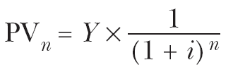
3.3 Assessing Project Feasibility
3.3.3 The Time Value of Money (Cont.)
Factors to be considered in Feasibility Analysis
Economic
Technical
Operational
Scheduling
Legal and Contractual
Political
CLOSE
Net Present Value
PVn = present value of Y dollars n years from now based on a discount rate of i.
NPV = sum of PVs across years.
Calculates time value of money
ECONOMIC
13 of 13

Slide 32
3.3 Assessing Project Feasibility
3.3.3 The Time Value of Money (Cont.)
Factors to be considered in Feasibility Analysis :
Economic
CLOSE
NPV example:
Suppose one of the benefits of a new project is that three years in the future it will save $10,000 during that year. Suppose the organisation believes its investments should earn at least 12% per year. What is the present value of that benefit?
PV₃ = $10,000 X 1 / (1 + .12) ³
$10,000 X ( .71178)
PV₃ =
= $7,178
14 of 13

Slide 33

3.3 Assessing Project Feasibility
3.3.3 The Time Value of Money (Cont.)
Factors to be considered in Feasibility Analysis
Economic
Technical
Operational
Scheduling
Legal and Contractual
Political
CLOSE
Break-even analysis
ECONOMIC
A type of cost-benefit analysis to identify at what point
(if ever) benefits equal costs
13 of 13

Slide 34
3.3 Assessing Project Feasibility
3.3.4 Assessing Technical Feasibility (Cont.)
Factors to be considered in Feasibility Analysis
Technical
Technical feasibility: a process of assessing the organisation’s ability to develop a proposed system
Technical Feasibility is threaten when :
Projects are large
The development group is not familiar with the technology
The user group is not familiar with the application area
Economic
Technical
Operational
Scheduling
Legal and Contractual
Political
CLOSE
TECHNICAL
1 of 6

Slide 35
3.3 Assessing Project Feasibility
3.3.4 Assessing Technical Feasibility (Cont.)
Factors to be considered in Feasibility Analysis
The potential consequences of not assessing and managing risks
can include the following:
Failure to attain expected benefits from the project,
Inaccurate project cost estimates,
Inaccurate project duration estimates,
Failure to achieve adequate system performance levels, and
Failure to adequately integrate the new system with existing hardware, software, or organisational procedures.
Economic
Technical
Operational
Scheduling
Legal and Contractual
Political
CLOSE
TECHNICAL
2 of 6

Slide 36
3.3 Assessing Project Feasibility
3.3.4 Assessing Technical Feasibility (Cont.)
Factors to be considered in Feasibility Analysis: Project Risk factors
Economic
Technical
Operational
Scheduling
Legal and Contractual
CLOSE
Political
Project size | Team size, organizational departments, project duration, programming effort
Project structure | New system or renovated system, resulting organisational changes, management commitment, user perceptions changes resulting from system
Development group | Familiarity with platform, software, development method, application area, development of similar systems
User group | Familiarity with Information System development process, application area and use of similar systems
TECHNICAL
3 of 6

Slide 37
3.3 Assessing Project Feasibility
3.3.4 Assessing Technical Feasibility (Cont.)
Factors to be considered in Feasibility Analysis: Project Risk factors
Risk can be managed on a project by:
Changing the project plan to avoid risky factors.
Assigning project team members to carefully manage the risky aspects.
Setting up monitoring methods to determine whether or not potential risk is, in fact, materializing.
Economic
Technical
Operational
Scheduling
Legal and Contractual
Political
CLOSE
TECHNICAL
4 of 6

Slide 38
3.3 Assessing Project Feasibility
3.3.4 Assessing Technical Feasibility (Cont.)
Factors to be considered in Feasibility Analysis : Project Risk factors
Economic
Four general rules emerged as technical risk assessments:
Technical
Operational
Scheduling
Legal and Contractual
Political
CLOSE
1
Larger projects are riskier than smaller projects.
A system in which the requirements are easily obtained and highly structured will be less risky than one in which requirements are messy, ill structured, ill defined, or subject to the judgment of an individual.
The development of a system employing commonly used or standard technology will be less risky than one employing novel or nonstandard technology.
A project is less risky when the user group is familiar with the systems development process and application area than if unfamiliar.
2
TECHNICAL
3
4
3 of 6

Slide 39
3.3 Assessing Project Feasibility
3.3.4 Assessing Technical Feasibility (Cont.)
Factors to be considered in Feasibility Analysis: Project Risk factors
Economic
Technical
Operational
Scheduling
Legal and Contractual
Political
 |  | Low Structure | High Structure
High Familiarity With Technology Or Application Area | Large Project | (1) Low risk (very susceptible to mismanagement) | (2) Low risk
 | Small Project | (3) Very low risk (very susceptible to mismanagement) | (4) Very low risk
Low Familiarity With Technology Or Application Area | Large Project | (3) Very high risk | (6) Medium risk
 | Small Project | (7) High risk | (8) Medium- low risk
CLOSE
Effects of degree of project structure, project size, and familiarity with
application area on project implementation risk (Source: Based on 7th Applegate, Austin, and McFarlan. 2007; Tech Republic, 2003.)
TECHNICAL
6 of 6

Slide 40
3.3 Assessing Project Feasibility
3.3.2 Other Feasibility Studies
Factors to be considered in Feasibility Analysis
Operational
Does the proposed system solve problems or take advantage of opportunities?
Operational Feasibility threatened when the proposed system :
Does not fit the existing Information System plan
Does not fit existing organisation structure and procedures
Economic
Technical
Operational
Scheduling
Legal and Contractual
Political
CLOSE
OPERATIONAL

Slide 41

3.3 Assessing Project Feasibility
3.3.2 Other Feasibility Studies (FA) (Cont.)
Factors to be considered in Feasibility Analysis
CLOSE
Scheduling
Can the project time frame and completion dates meet organisational deadlines?
What tasks have to be done?
Who will do the tasks?
When will they get done?
What happens if you miss the deadline?
Economic
Technical
Operational
Scheduling
Legal and Contractual
Political
SCHEDULING
Fig. 17

Slide 42
3.3 Assessing Project Feasibility
3.3.2 Other Feasibility Studies (FA) (Cont.)
Factors to be considered in Feasibility Analysis
Legal and Contractual
What are legal and contractual ramifications of the proposed system
development project?
Examples of legal and Contractual issues :
Copyright
Contracts
Antitrust
Software licenses
Labour laws and unions
International law
CLOSE
Economic
Technical
Operational
Scheduling
Legal and Contractual
Political
LEGAL AND CONTRACTUAL

Slide 43
3.3 Assessing Project Feasibility
3.3.2 Other Feasibility Studies (FA) (Cont.)
Factors to be considered in Feasibility Analysis
Political
How do key stakeholders view the proposed system?
Who are the stakeholders?
What power do they have?
Economic
Technical
Operational
Scheduling
Legal and Contractual
Political
CLOSE
POLITICAL

Slide 44
3.3 Assessing Project Feasibility
Class activity
Factors to be considered in Feasibility Analysis
Economic
What are the factors to be considered in feasibility analysis?
Answer :
Factors to be considered in feasibility analysis are :
Economic
Technical
Operational
Scheduling
Legal and contractual
Political
2. Differentiate between tangible and intangible benefits .
Technical
Operational
Scheduling
Legal and Contractual

Slide 45
3.3 Assessing Project Feasibility
3.3.3 Building the Baseline Project Plan
Baseline Project Plan (BPP)
is a document intended primarily to guide the development team.
4
Sections:
INTRODUCTION
SYSTEM DESCRIPTION
FEASIBILITY ASSESSMENT
MANAGEMENT ISSUES

Slide 46
3.3 Assessing Project Feasibility
3.3.3 Building the Baseline Project Plan (Cont.)
CLOSE
INTRODUCTION
Project Scope statement is part of the BPP introduction.
Sections:
Problem statement
Project objectives
Project description
Business benefits
Deliverables
Expected duration
1 of 3

Slide 47
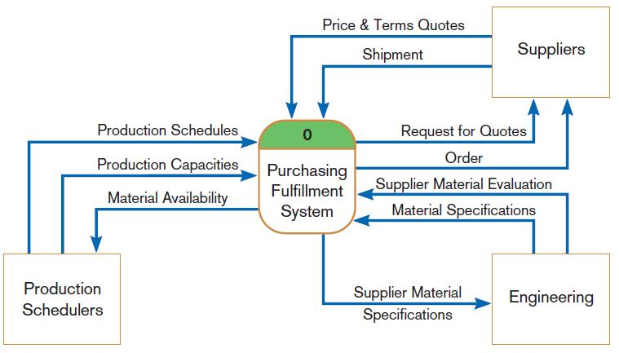
3.3 Assessing Project Feasibility
3.3.3 Building the Baseline Project Plan (Cont.)
CLOSE
INTRODUCTION
Diagram Depiction of Project Scope
Business benefits
Deliverables
Expected duration
Fig. 18
Context-level data flow diagram showing project scope for Purchasing Fulfillment System (Pine Valley Furniture)
2 of 3

Slide 48
3.3 Assessing Project Feasibility
3.3.3 Building the Baseline Project Plan (Cont.)
CLOSE
INTRODUCTION
Factors in Determining Scope
Organizational units affected by new system Such as accounting department implemented computerised payroll system
Current systems that will interact with or change because of new system . Eg. From Manual payroll system to Computerized payroll system
People who are affected by new system such as employees and staff of accounting department .
Range of potential system capabilities such as calculating employees with less time and cost
3 of 3

Slide 49

3.3 Assessing Project Feasibility
CLOSE
SYSTEM DESCRIPTION
Provides description of the selected configuration, input information, tasks performed and resultant information.
System description section outlines possible alternative solutions.
The alternative Solution can be :
Web based online system
Mainframe with Central Database
Local Area network with centralised
database etc.
Fig. 19
Example of an Application

Slide 50
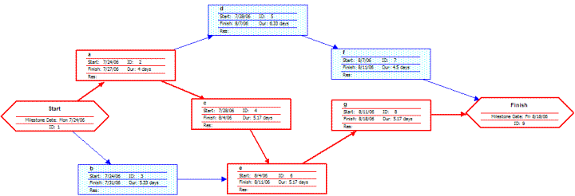
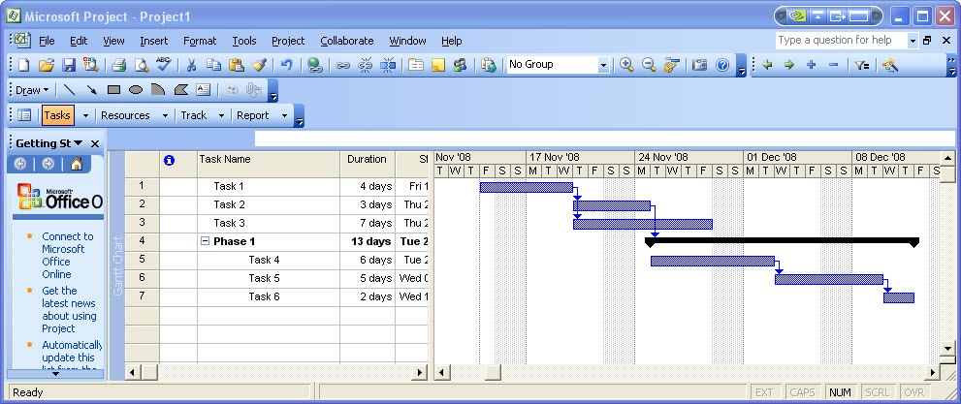
3.3 Assessing Project Feasibility
FEASIBILITY ASSESSMENT
CLOSE
Feasibility assessment section outlines issues related to project costs and benefits, technical difficulties, and other such concerns.
Project Schedule are specified using Gantt chart and network Diagram
Estimate of the resource requirement can be made : E.g. Human resource
The greatest amount of project Planning effort is expended on feasibility assessment .
Fig. 20
Network diagram
Gantt Chart
Fig. 21

Slide 51
3.3 Assessing Project Feasibility
CLOSE
MANAGEMENT ISSUE
Management issues section outlines a number of managerial concerns related to the project.
Team management: provides description of the team member roles and reporting relationship
Communication Plan: provides description of the communication procedures to be followed by management , team members and customers.
Project Stand and Procedures: Provides a description of how deliverables will be evaluated and accepted by the customers

Slide 52
3.3 Assessing Project Feasibility
3.3.4 Reviewing the Baseline Project Plan
Structured Walkthroughs
Base line project plan will be reviewed before going to a next phase of
SDLC and the review is known as Structured Walkthroughs
Structured Walkthrough is a peer group review of any product created
during the system development process
The role of the group members can be coordinator, presenter, user,
secretary, standard-bearer, maintenance oracle

Slide 53
ACTIVITY
Class Activity
Answer the following questions.
1. List and discuss the different types of project feasibility factors. Is any one factor most important? Discuss why or why not ?
2. What intangible benefits might an organisation obtain from the development of an information system?

Slide 54
SUMMARY
Things to be considered when initiating projects are: the effort that should be expended on the Project initiation and Planning process, the person who is responsible for performing the Project initiation and planning process and the challenging activities in project initiation and planning
Base Project Plan is a major outcome and deliverable from the Project initiation and planning phase
Feasibility Analysis guides the organisation whether to proceed with a project
Tangible benefits refer to items that can be measured in dollars and with certainty.

Slide 55
SUMMARY
Intangible benefits are benefits derived from the creation of an information system that cannot be easily measured in dollars or with certainty
Tangible cost: a cost associated with an information system that can be measured in dollars and with certainty
Intangible cost: a cost associated with an information system that cannot be easily measured in terms of dollars or with certainty

Slide 56
REFERENCE
Hoffer, J.G.V. (2009). Modern System Analysis and Design (6th Ed.). (n.p)

Slide 57
APPENDIX
Figure | Source
Fig. 1 | http://www.nedfonusa.com/images/Company%20Building.jpg
Fig. 2 | http://img.ehowcdn.com/article-page-main/ehow/images/a07/6p/m4/calculate-payroll-800x800.jpg
Fig. 3 | http://www.einflatables.com/images/Business_opps_home_booming.gif
Fig. 4 | http://recruitinginhealthcare.files.wordpress.com/2011/07/employees.jpg
Fig. 5 | http://3.bp.blogspot.com/_anSrjJvD4dQ/TTcxRhgpWnI/AAAAAAAAARw/jTA3aXSoPio/s1600/employee_group.jpg
Fig. 6 | http://empxtrack.com/blog/wp-content/uploads/2010/01/manual-payroll-system.jpg
Fig. 7 | http://www.dkimages.com/discover/home/Business/Moving-to-E-Business/Moving-to-E-Business-11.html
Fig. 8 | http://www.pointeightgraphics.com/sitebuildercontent/sitebuilderpictures/interview2.jpeg

Slide 58
APPENDIX
Figure | Source
Fig. 9 | http://cdn3.wn.com/pd/09/fe/9cf1c437b34f1131b7938bb93323_grande.jpg
Fig. 10 | http://blog.promodo.com/wp-content/uploads/2011/03/seo-developers.jpg
Fig. 11 | HTTP://LAURAWILSONONLINE.COM/WP-CONTENT/UPLOADS/2010/11/ONLINE-BRAND-BUILDING.JPG.
Fig. 12 | http://www.comtrade.com/wp-content/uploads/EdIT2011_3.jpg
Figure 13 | Jeffrey A.Hoffer, J.G.V. (2009), Modern System Analysis and Design (6th Ed.)
Figure 14 | Schwalbe, K. (2010). Information Technology Project Management (6th Ed. ed.): Course Technology.
Figure 15 | http://laurawilsononline.com/wp-content/uploads/2010/11/online-brand-building.jpg
Figure 16 | http://laurawilsononline.com/wp-content/uploads/2010/11/online-brand-building.jpg

Slide 59
APPENDIX
Figure | Source
Fig. 17 | http://timsteeves.com/wp-content/uploads/2010/10/project_management.jpg
Fig. 18 | Jeffrey A.Hoffer, J.G.V. (2009), Modern System Analysis and Design (6th Ed.)
Fig. 19 | www.google.com
Fig. 20 | http://wpcontent.answers.com/wikipedia/en/4/40/Pert_example_network_diagram.gif
Figure 21 | http://3.bp.blogspot.com/_ZTG0gAdd1k8/TC8hcOrx1VI/AAAAAAAAAhI/TDrudXBsGzA/s1600/example-ms-project-gantt-chart2.jpg

